Slide 1
Research Methods and Practice
Literature Review
Jim Buckley, T2-015
Jim.buckley@ul.ie.
Week 3

Slide 2
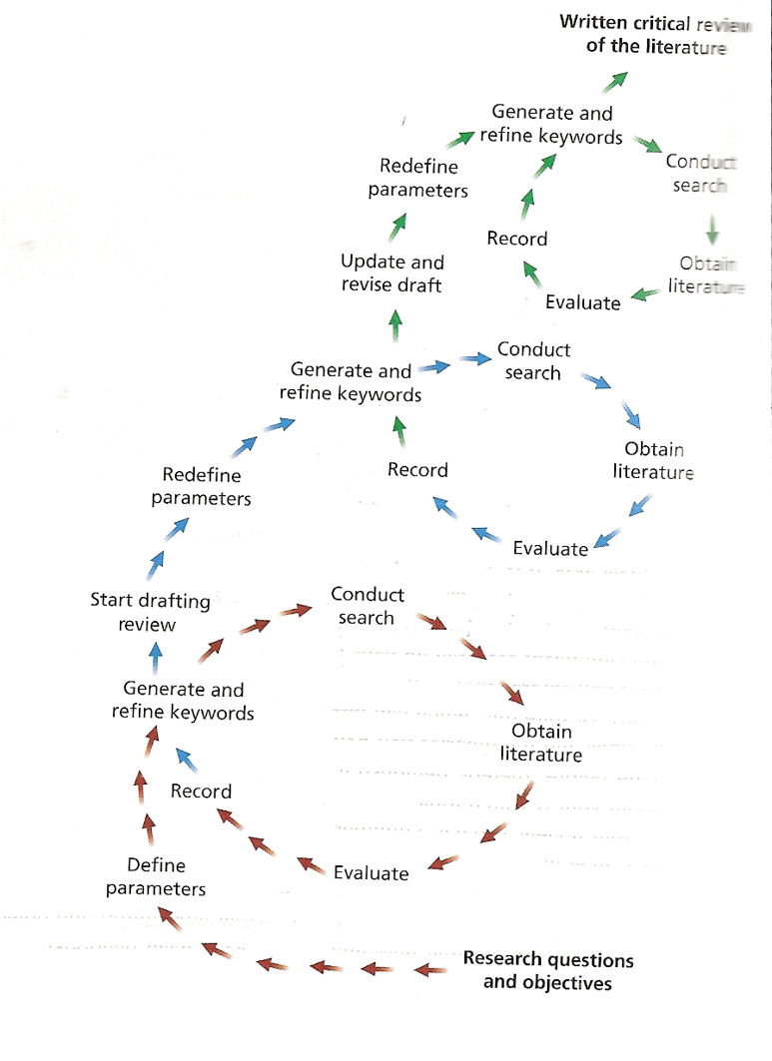
Last Week
Review approaches:
  Mapping Studies (MS)
  SLRs
  Critical Review process
Critical reviewing:
  “The deadly truth…” article
  Guidelines
    Purpose
    General how-to
    Coverage and objectivity
  Crombie’s guidelines
Generating a Research Question:
  Generation/The Delphi, brainstorming approach
  Criteria for a good research topic
  Examples from my PhD’s past.
Misc:
  Poster exercise
  Another empirical design exercise
  Plagiarism
  A last critical reading exercise: The Spreadsheet paper
Notes:
Purpose:
To identify key points / trends.
To identify gaps / explicit recommendations for further work;
To stop you repeating others work;
IE: To define/refine your research question;
To identify an appropriate empirical method;
How to:
Previewing: establish how it will inform your work;
Annotating: dialog with the author (no highlighters)
Summarize;
Compare and contrast to other work;
Be transparent, so others can replicate or even extend / improve as time goes on.
Have you referred to recognised experts in the field, and looked in peer reviewed forums;
Is the literature covered relevant to your theme question and are the leading theories covered?
Have you assessed strengths and weaknesses in this work and been objective, even to the degree of including opinions differing from your own?
Have you justified your own (possibly resultant) ideas, through showing gaps / inconsistencies, in the current literature?

Slide 3
Table of Contents
Honing in on a Research Question
Poster Presentation week 8
Empirical Design Exercise
Plagiarism
Pointer to EndNote
Last critical reading exercise

Slide 4
Generating a research idea
Examine own strengths, interests and weaknesses: subject area
Preliminary Research Review
Management (if working)
Browse past project titles / abstracts
Discuss with (potential) supervisor
Notebook of ideas
Brainstorming with Peers
Notes:
Strenghts and weaknesses: Module results
Past projects are very good in giving you a standard to go against as well
Lit review based on modules: textbooks can lead to references, as can lecturers
Brainstorming: Define (as best as possible), solicit suggestions, record (no criticism), evaluate/review, iterate
Mgt where working: sensitivities: can have 2 masters: academic and industry – for eg – mgt may want to justify position, not evaluate it. Likewise, not development

Slide 5
Refine Towards Ideas:
Delphi meetings:
  State general research area/preliminary research ideas;
  Others seek clarifications;
  Ask each group member to generate X research ideas from that, ideally with justification;
  Distribution of ideas to group (anonymous)
  Cycle round again
  Get the proposers to revise their own ideas
  Or propose new ones/support others
Notes:
Delphi is a research method: what do you think its good for and bad for?

Slide 6
Criteria for a Good Research Topic
Sustains your interest;
Capability (comfort zone, finances, access to data);
Sufficient, yet sufficiently-scoped, area of study;
Symmetry of potential research outcomes;
Career goals alignment;
Notes:
For sufficiency point and symmetry point use SQ-EQ example

Slide 7
Research Question Criteria
Criteria:
  Scope (The goldilocks test);
  Must generate/assess new insight:
  Not necessarily new theory but it must have (at least an hypothesised) ‘why’ aspect;
Notes:
To big / small, too hot = too sensitive, too cold + no one interested
Instead of theory – theory can be assessed – information foraging, kill-foraging

Slide 8
But still… Importance of Theory
EG:
  LOC are a primary quality prediction measure because...
  Crowd-sourcing increases productivity in composition of code but decreases quality/ reliability, because...
  Staff are reluctant to adopt a new IS because…
Notes:
Hence the prevalence of words like explain, relationships, compare, contrast, predict, describe, generalize

Slide 9
The Research Question / Positioning based on Literature
  Mapping studies (Von Mayrhauser);
  Evaluate academic papers thoroughly: is ALL of this believable? (O’Brien and Buckley)
  Applying across domains:
    Find commonalities / differences (O’Brien et al.);
    Bloom’s taxonomy;
  Assess future work (LeGear);
  Developer comments (Jacek Rosik)
Notes:
A pre-requisite for an SLR – but
Basically, you have to be an expert in your chose field before you can hope to come up with something sensible. So you often have to read and process the works of experts to make up the question in the first place.
This is often called a state-of-the-art review
An example of this is (I think ‘O’Brien and Buckley’, which I will be giving you out to read in our next lecture. When you get it, see how it understands and compares the work of experts to derive something new.)
One which takes this a step further (to evaluate) is ‘O Brien and Buckley’s work on software comprehension. Everyone interpreted Soloway incorrectly and we showed this to be the case, showing a difference between Soloway and Brooks.

Slide 10
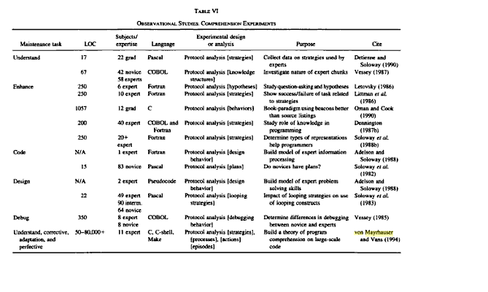
Software Comprehension Review

Slide 11
The Research Question / Positioning based on Literature
  Mapping studies (Von Mayrhauser);
  Evaluate academic papers thoroughly: is ALL of this believable? (O’Brien and Buckley)
  Applying across domains:
    Find commonalities / differences (O’Brien et al.);
    Bloom’s taxonomy;
  Assess future work (LeGear);
  Developer comments (Jacek Rosik)
Notes:
A pre-requisite for an SLR – but
Basically, you have to be an expert in your chose field before you can hope to come up with something sensible. So you often have to read and process the works of experts to make up the question in the first place.
This is often called a state-of-the-art review
An example of this is (I think ‘O’Brien and Buckley’, which I will be giving you out to read in our next lecture. When you get it, see how it understands and compares the work of experts to derive something new.)
One which takes this a step further (to evaluate) is ‘O Brien and Buckley’s work on software comprehension. Everyone interpreted Soloway incorrectly and we showed this to be the case, showing a difference between Soloway and Brooks.

Slide 12
Believability
Von Mayrhauser and Vans wrote the definitive article on software comprehension (mapping study) but:
  Considered Soloway / Books as one;
Based on our deep understanding, we didn’t agree;
  We set out to find a way to distinguish them and empirically proved their independent existence;

Slide 13
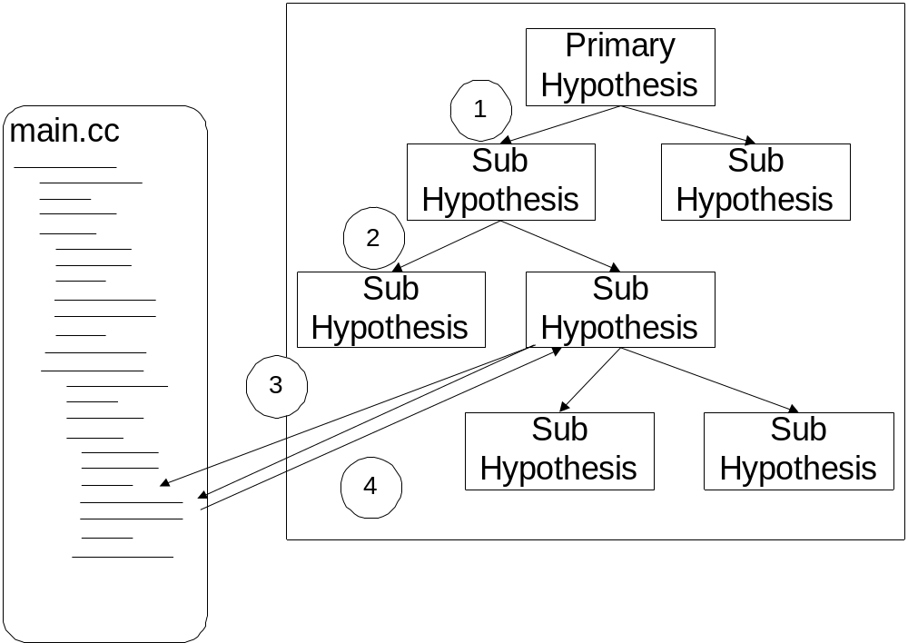
Notes:
Brooks

Slide 14
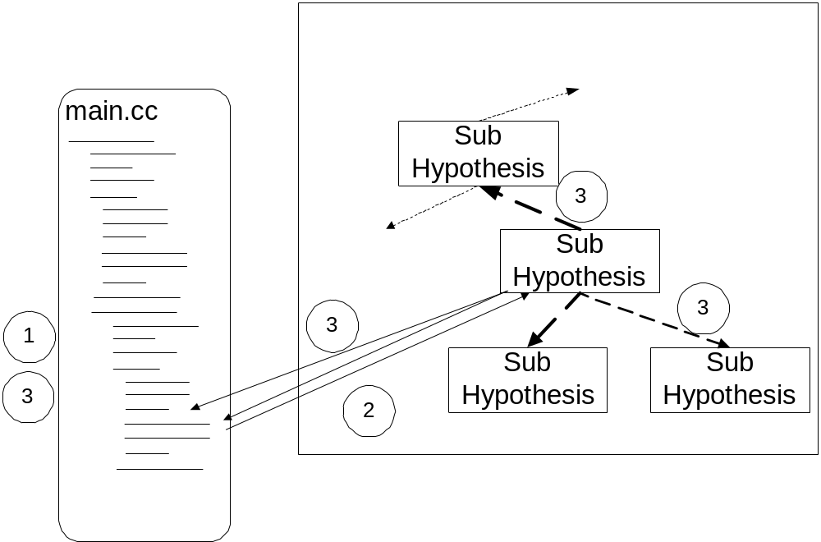
Notes:
Soloway

Slide 15
Interestingly…
  In the last time quartile of the associated study programmers went at the code bottom-up!
  Why?
    Bottom-up is considered degenerative behaviour?
    Maybe they had understood it at an abstract level and progressed to detailed level
    From ‘what’ to ‘how’
  Are software comprehension models phased (and why)?
  Would this happen in industry?

Slide 16
The Research Question / Positioning based on Literature
  Mapping studies (Von Mayrhauser);
  Evaluate academic papers thoroughly: is ALL of this believable? (O’Brien and Buckley)
  Applying across domains:
    Find commonalities / differences (O’Brien et al.);
    Bloom’s taxonomy;
  Assess future work (LeGear);
  Developer comments (Jacek Rosik)
Notes:
A pre-requisite for an SLR – but
Basically, you have to be an expert in your chose field before you can hope to come up with something sensible. So you often have to read and process the works of experts to make up the question in the first place.
This is often called a state-of-the-art review
An example of this is (I think ‘O’Brien and Buckley’, which I will be giving you out to read in our next lecture. When you get it, see how it understands and compares the work of experts to derive something new.)
One which takes this a step further (to evaluate) is ‘O Brien and Buckley’s work on software comprehension. Everyone interpreted Soloway incorrectly and we showed this to be the case, showing a difference between Soloway and Brooks.

Slide 17
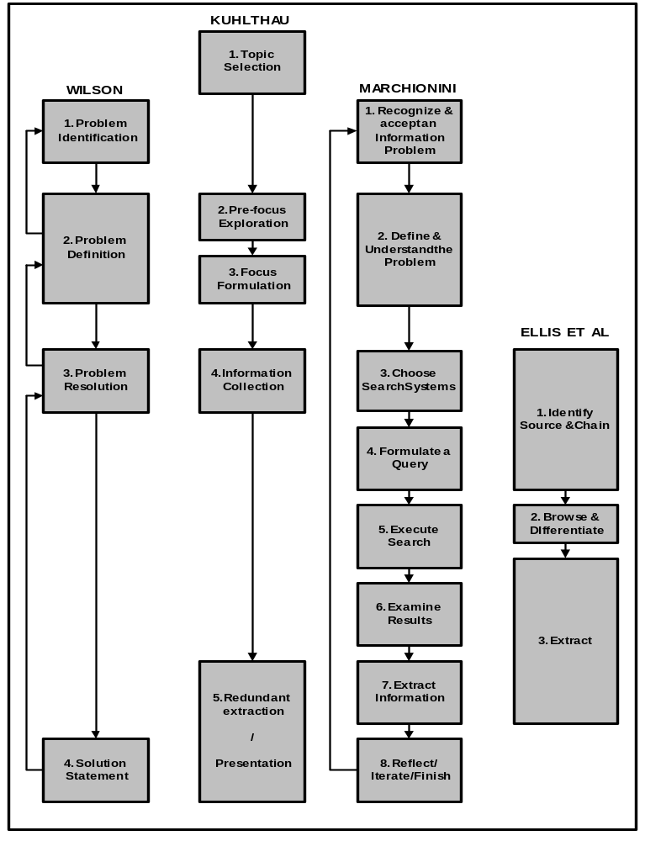

Slide 18
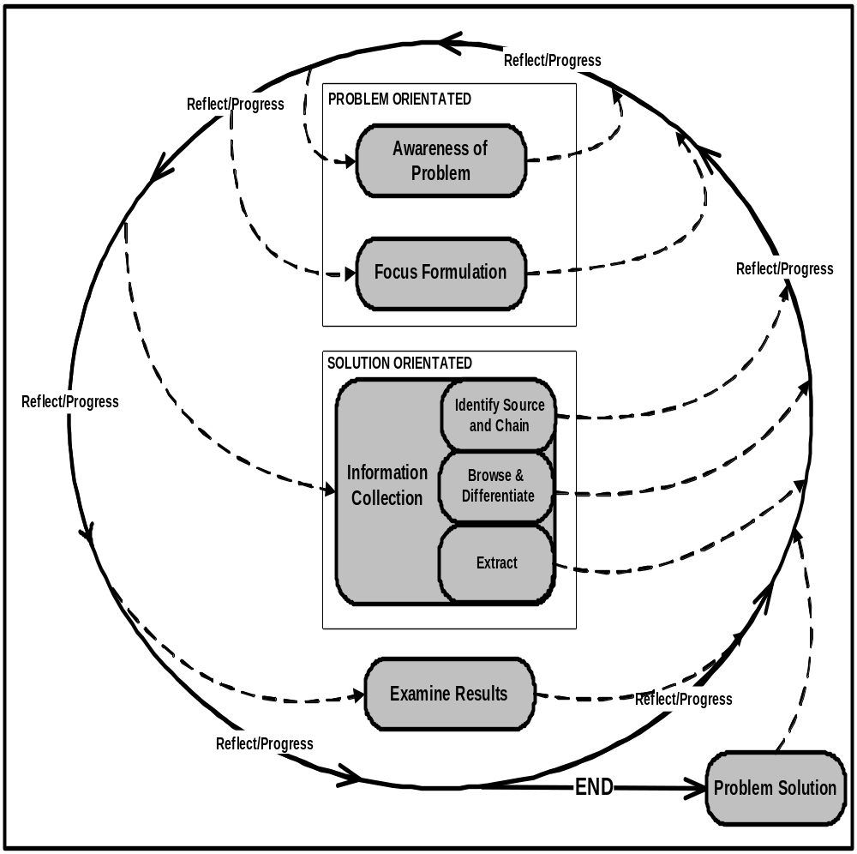
Notes:
And indeed there was one we missed – Concept Analysis extern at Michael’s viva informed us of this and asked for its inclusion. Luckily our results tied in well with CA and it was not a big blip.

Slide 19
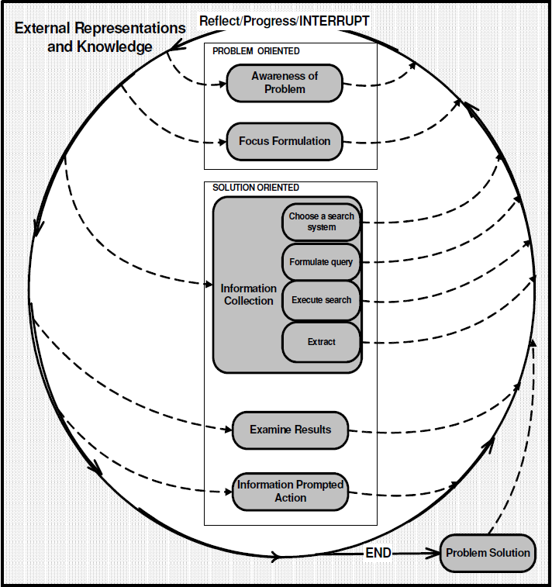

Slide 20
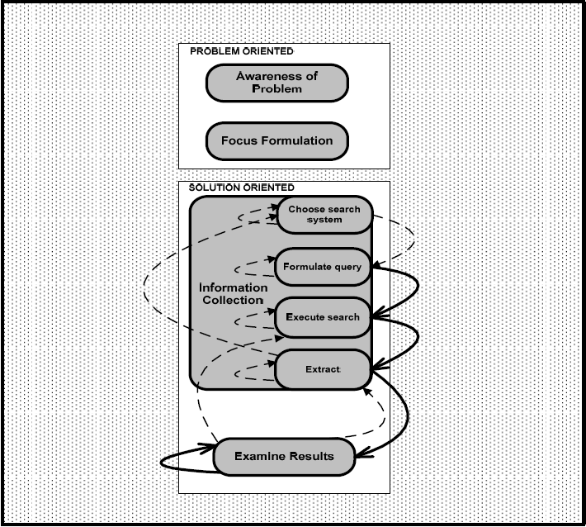

Slide 21
The Research Question / Positioning based on Literature
  Mapping studies (Von Mayrhauser);
  Evaluate academic papers thoroughly: is ALL of this believable? (O’Brien and Buckley)
  Applying across domains:
    Find commonalities / differences (O’Brien et al.);
    Bloom’s taxonomy;
  Assess future work (LeGear);
  Developer comments (Jacek Rosik)
Notes:
A pre-requisite for an SLR – but
Basically, you have to be an expert in your chose field before you can hope to come up with something sensible. So you often have to read and process the works of experts to make up the question in the first place.
This is often called a state-of-the-art review
An example of this is (I think ‘O’Brien and Buckley’, which I will be giving you out to read in our next lecture. When you get it, see how it understands and compares the work of experts to derive something new.)
One which takes this a step further (to evaluate) is ‘O Brien and Buckley’s work on software comprehension. Everyone interpreted Soloway incorrectly and we showed this to be the case, showing a difference between Soloway and Brooks.

Slide 22
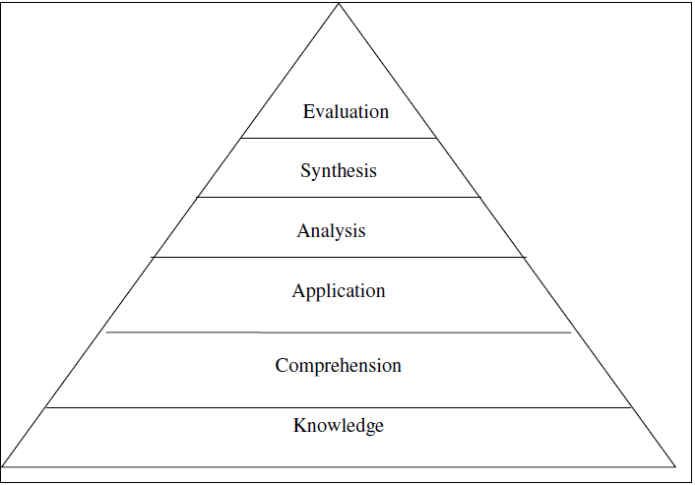
‘Bloom’ing Programmers
Material from:
  Pedagogical, cognitive area;
  Applied to programmers;
  With a better coding protocol than a verb table:
    Reductionism.
    Ambiguity.
    Bucket phrases.
  Comprehension focus;
  Cumulative hierarchy;
Notes:
Richer analysis schema: not words like compile, contrast (ambiguous between comprehension and analysis)
Number of bucket phrases left out

Slide 23
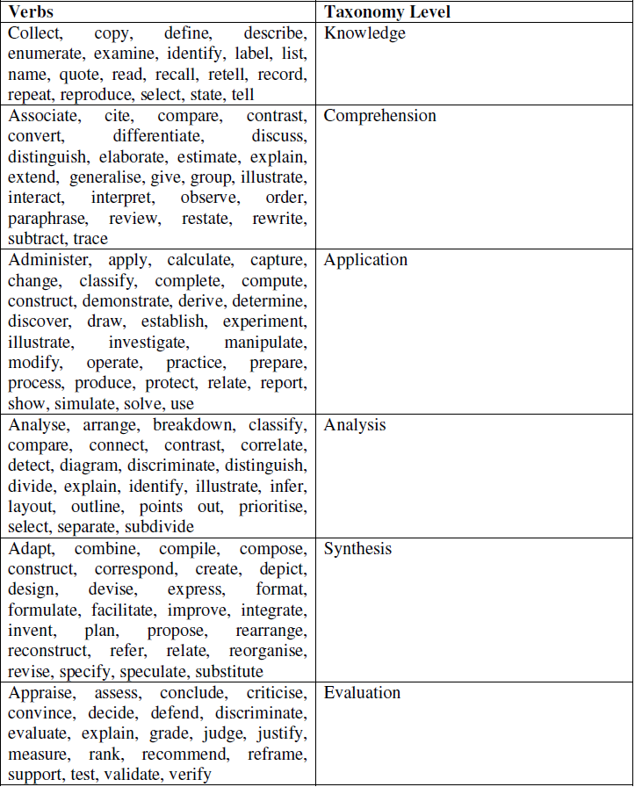
Notes:
Reductionism
Dual purpose words: distinguish: comprehension and analysis

Slide 24
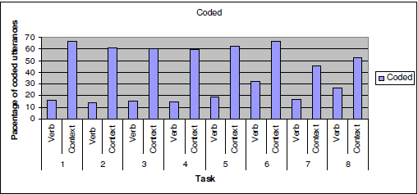
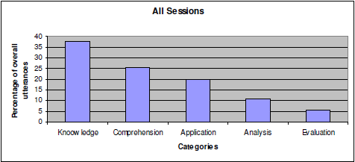
Results
Notes:
A context-aware analysis scheme for bloom's taxonomy

Slide 25
Again… Research prompts Research
Do higher levels build on lower levels?
Why no synthesis?
Ramping-up newbies?
Lets see where others have taken it:
  “A context-aware analysis scheme for Bloom’s Taxonomy”
  How (*2)?
Notes:
A quick titling review
A quick cited by review

Slide 26
The Research Question / Positioning based on Literature
  Mapping studies (Von Mayrhauser);
  Evaluate academic papers thoroughly: is ALL of this believable? (O’Brien and Buckley)
  Applying across domains:
    Find commonalities / differences (O’Brien et al.);
    Bloom’s taxonomy;
  Assess future work (LeGear);
  Developer comments (Jacek Rosik)
Notes:
A pre-requisite for an SLR – but
Basically, you have to be an expert in your chose field before you can hope to come up with something sensible. So you often have to read and process the works of experts to make up the question in the first place.
This is often called a state-of-the-art review
An example of this is (I think ‘O’Brien and Buckley’, which I will be giving you out to read in our next lecture. When you get it, see how it understands and compares the work of experts to derive something new.)
One which takes this a step further (to evaluate) is ‘O Brien and Buckley’s work on software comprehension. Everyone interpreted Soloway incorrectly and we showed this to be the case, showing a difference between Soloway and Brooks.

Slide 27
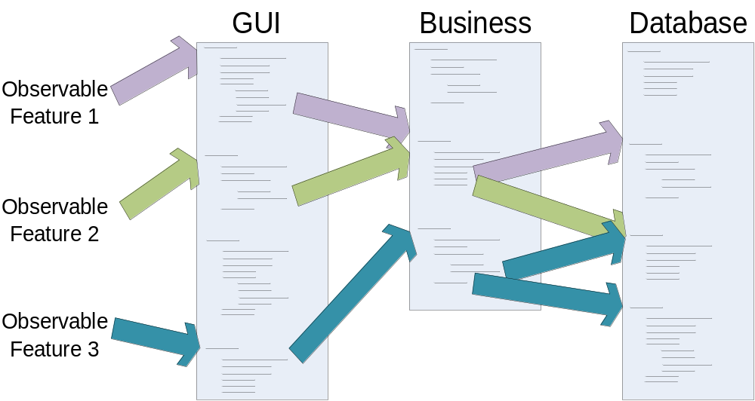
Le Gear: Reconnaissance
Notes:
Point out that this is a dynamic analysis technique, and previous 2 = static analysis technique
Draw the eggshell (venn diagram) to illustrate Uniquely Involved, Common etc.

Slide 28
Future Work
Wilde suggested Shared sets but didn’t explore:
LeGear et al. explored:
  Shared code, across features;
  Cross-feature re-use;
  Generic, core, reusable code;
  Basis for component recovery;
Notes:
Small step so that we can defend it, scope it.
Empirical Assessment:
Realistic, in-vivo studies;
Very small cohort of participants;
Not-controlled experiments – other factors may have played a role;
Hawethorne effect
Newton’s expansion of gravity is interesting in that it seems like a really big jump but not – done in a series of steps.

Slide 29
The Research Question / Positioning based on Literature
  Mapping studies (Von Mayrhauser);
  Evaluate academic papers thoroughly: is ALL of this believable? (O’Brien and Buckley)
  Applying across domains:
    Find commonalities / differences (O’Brien et al.);
    Bloom’s taxonomy (Tara Kelly);
  Assess future work (LeGear);
  Chatting with Experts (Jacek Rosik)

Slide 30
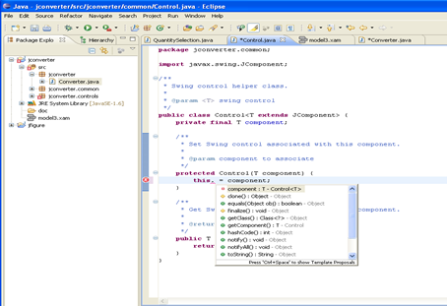

Architecture Recovery at IBM
As-Designed
Architecture
As-Implemented
Architecture
Implementation
GUI
GUI
B
B
DB
DB
Our Job: to recover from the inconsistencies
Notes:
Why: system ability to meet the requirements is compromised
Point out it may be 2 way – implementation can give insight to arch

Slide 31
Findings: Moving past positioning
  O’Brien – Software Comprehension models:
    Gathered programmer data (empirical evaluation);
  O’Brien – Information Seeking model:
    Gathered think-aloud data (empirical evaluation);
  Kelly – Bloom taxonomy:
    Schema and usage of (Mike’s) think-aloud data
  LeGear – Component Recovery:
    Developed an approach and developed / adopted / combined tools to support the approach (Design research);
    Assessed usability in-vivo (successful);
  Rosik: - Architecture Consistency
    Identified JIT need for consistency through empirical studies;
    Built prototype tool;
    Evaluated it on students and many professionals;
Notes:
Often academics have based their direction just on literature review, prompting a general feeling that the fall into the mistakes of their (academic) forefathers and become less and less relevant to actuality. Another way to position yourself is to use empirical evidence. That is, go out and observe practice, interview experts on what really works, perform secondary analysis
Obviously the 2 streams (empirical evidence, literature) are not mutually exclusive. A researcher can have done an empirical study and can report it in an academic paper, which can then be found by you in your literature review.

Slide 32
Week 8 exercise: Poster Presentation
You need to create an academic poster
The poster should review and summarize 4 articles, as seeded by the article I gave your course on week 2.
For SD students it should be the O’Donnell pair programming paper
For SE students, it should be the Chidamber and Kamerer paper
In groups of 4 you should ‘move out’ from that original paper to find 3 extra papers from that first paper. This ‘moving out’ process should be led by enquiry: what the first paper doesn't expand on that interests you, or that you feel should be there, or points it provides insufficient evidence for, etc. Thus, you build from that first paper.
Notes:
Research question:
Types of questions that help design Why, What, Who, How, Where, When – the latter 4 (hopefully leading us to defensible , rigorous, transparent evidence.
We have stated the what. Now on to the why: real world importance obvious – but is there a theory/conceptual basis
Read aggressively, write defensively, to obtain and refine a position, knowing the state of the art as you go: what strategies proposed and based on what conceptual models

Slide 33


Slide 34
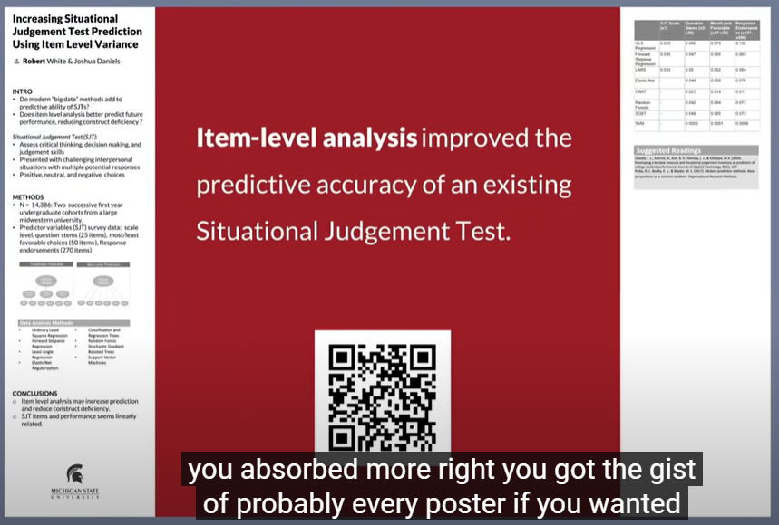
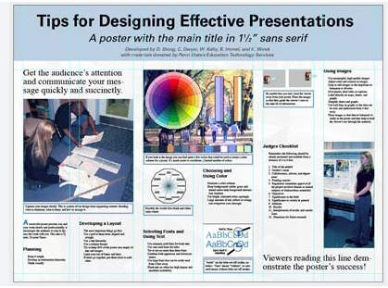
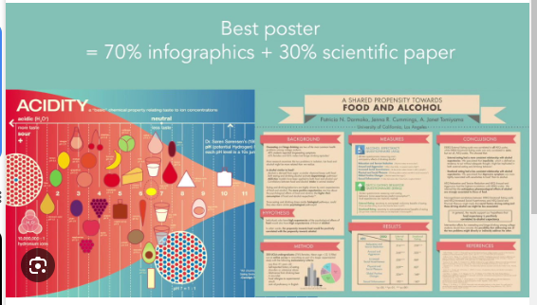
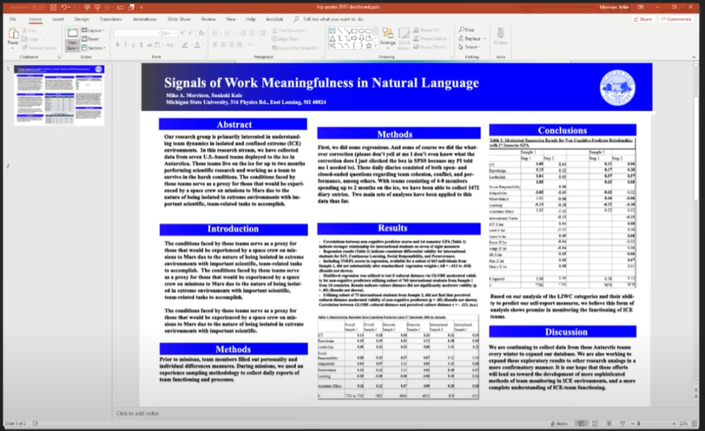
Good academic posters?
Notes:
https://www.youtube.com/watch?v=1RwJbhkCA58 : really interesting presentation
6 mins in: design

Slide 35
Academic Posters
Where are they presented?
What’s the environment?
For what purpose
Attributes:
  https://www.youtube.com/watch?v=1RwJbhkCA58
  The user-case for a new design (0 – 4:36)
  The resulting artifact: (13:00-16:15)
    The main research finding (plain language), and a QR code
    The ammo-bar
    The silent presenter bar
  Addressing user goals (16:16-19:31)
Are your goals EXACTLY the same?
Notes:
Context: 5 minute engagement to interested experts
Engagement, insight-transferrence, leave the good, more detailed stuff for discussion
Look at 9 mins

Slide 36
Good academic posters
Notes:
https://www.youtube.com/watch?v=1RwJbhkCA58 : really interesting presentation
6 mins in: design

Slide 37
Marking
Creativity – 4
Traceable Summary – 5 (references cited)
Critical review (based on these papers only) – 6
Research Question chosen - 5
Notes:
Context: 5 minute engagement to interested experts
Engagement, insight-transferrence, leave the good, more detailed stuff for discussion
Look at 9 mins

Slide 38
Empirical Design exercise SE
A new Financial Information System is being introduced by you into your client’s company:
Your job is
  To determine broad swell of feelings towards the new system and determine key insights;
  To determine how people work with the new system, particularly the difficulties they encounter;
Notes:
Context: Read the literature (what to expect, how others have studied this)
When: after introduction – over several months
Who: Diverse populations: users, people who rely on users to get info (managers)
How: Delphi (fears, hopes, biggest issues), survey retrospective assessment of these fears, hopes, issues (with ‘other’ fields to determine new ones
What: survey what would you ask, likewise what would be the theme of the delphi
Analysis: listing of prevalent fears, hopes etc,
Why: knowing this we can direct our study better: to quell discontent? to identify training needs?
Other task: Think aloud is probably best – identify frustration moments, identify patterns of behaviour
2nd question could possibly be analysed by looking at back-outs on system by logging system usage

Slide 39
Issues
Design choices (contextualized by ‘Why’)?
  Who will participate?..
    What sample size?
  Piloting possible?
  When: Before, during or after?
  Where will the study happen?
  What data will you capture?
    How will you capture it?
    Any steps to make that data higher quality?
    How will you analyze that data?
  What will you report…?
  Ethics?
Notes:
Reporting: ethically, rigorously

Slide 40
What is Plagiarism
Definition:
  Passing off someone else’s work/ideas as your own;
  To use another’s work without crediting it;
Can you use other’s work?
  We did talk about ‘standing on the shoulders of giants’;
So how can we legitimately use others work?
  Yes, if you
    Acknowledge and
    ‘Own’ it.
Notes:
Quotation marks are appropriate when you take text directly from another source word for word. You should do this when the original author has put his idea very well and you cant think of a better way of phrasing it. Typically this should only be one or 2 sentences and taking stuff word-for-word does leave open the possibility that you haven’t mentally processed the material. You certainly should not have a page or more taken word-for-word from another text, even if you put it in quotation marks
A better way of using someone else’s material is paraphrasing it – changing the words and maybe changing the idea somewhat to make it fit more in with your agenda. This shows the reader that you have understood and the material and, if you have changed it to make it fit more into your agenda, you have shown that you can apply the information contained in the text to a new context.
In either case, (paraphrasing or quotation) you need to inform the reader that the material is borrowed and where the material came from. You do this my means of citation – putting a full reference to the original source at the back of your text in a bibliography and putting in a marker / pointer at the ‘used text’ to show the reader it is borrowed (and point them to the full reference at the back). We will look at the format of such citations during the ‘Research Methods’ course.

Slide 41
How to acknowledge: Cite It Right
http://libguides.ul.ie/citeitright (Harvard referencing style)
3 parts:
  The Reference: A full description of where readers can find every source you used (usually listed at the end of your text):
    Must contain:
      Name of authors;
      Year;
      Title;
      Increasingly the DOI;
      Depends on source:
        If Book – ISBN number, editors and title, chapter, pages
        If Journal: Name, volume number, number and page numbers;
        If conference proceedings– Name, location, page numbers;
        If website – http address and last accessed date
  The citation in the text itself:
    Brackets containing a unique link to the full description at end of text
    Author-based or numeric
  The text:
    ‘Direct takes’;
    Indirect takes.
Notes:
So in reality its 3 parts reference, citation and paraphrase, duplication

Slide 42
Reference list at the end of the text
Bowman, S.A., Gortmaker, S.L., Ebbeling, C.B., Pereira, M.A. and Ludwig, D.S. (2004) ‘Effects of fast-food consumption on energy intake and diet quality among children in a national household survey’, Pediatrics, 113(1), 112-118. doi: 10.1109/TSE.2004.3287297
Buckroyd, J. (1996) Eating Your Heart Out: Understanding and Overcoming Eating Disorders, 2nd ed., London: Vermilion. ISBN 786-9876
Caroli, M. (2004a) ‘Childhood obesity and the role of television’, Journal of Obesity, 28(5), 43-44. doi: 10.1109/JO.2004.3287281
Caroli, M. (2004b) ‘Role of television in adult obesity levels’, Proc. of the 17th Conference of the Interest Group of Obesity, London, 1303-1306.
Donnellan, E. (2005) ‘Obesity task force warns of epidemic’, The Irish Times, 17 May, page 7
Notes:
Alphabetic order
See Caroli 2004a, 2004b
Note order of author, year, title, title of source and then details
Note italics on title of source

Slide 43
The citation and the text itself
Short Quotations:
Put short quotations (around twenty words or less) in inverted commas within the text.
Society has developed a “boundary-free culture” (Critser 2003, p.31) which has affected our food consumption…
Long Quotations
Long quotations should be indented in a separate paragraph, in a smaller font. Cite the author and date in the same font and in brackets at the right margin of the page, under the quotation.
Nowhere did this new boundary-free culture of American food consumption thrive better than in the traditional American family, which by the ‘80s was undergoing rapid change. (Critser 2003, p.31)
Paraphrasing or Summarising
Paraphrasing is referring to a source without directly quoting from it. Here are 3 ways you might cite the same source, depending on how you have referred to it in your sentence.
It has been suggested that our culture is now without boundaries (Critser 2003, p.31) and…
OR
In a popular study, Critser (2003, p.31) argues that our culture is now without boundaries…
OR
In 2003, Critser (p.31) suggested that our culture has become boundary-less…
Notes:
Note that as you move towards longer usage of an article, it is more accepted that you paraphrase. Putting it in your own works suggests to reviewers like me that you understand the article, To copy verbatim, you need no such understanding
Note also that some citation styles require you to use numbers. These numbers uniquely link into the reference section at the back, whereas if you have the same author publish in the same year in this style, you have to use something like 2003a, to discriminate between the artilces listed at the end

Slide 44
The other way(!)
Another common format, as suggested by Thompson et al. is to just include numbers for references [3].
James et al. [1] point out that this facilitates reading of the article but other authors [2], [3] note that it hinders those who want an in-line indication of the source of the material.
References:
[1] James M.. (2007). “The joys of referencing styles”…
[2] Kitchenham B., Williams J. and Martin M.. (2004). “Why choose which referencing style”…
[3] Thompson G., Mooney B and O’Brian P. (2002). “A guide to referencing styles”…

Slide 45
Consequences of Plagiarism
  It means that you fail to acquire analytical evaluation skills / writing skills;
  It can give you a short-term advantage over the class;
  But its often obvious to academics, and we have help…;
  It destroys UL’s reputation;
  But seen as the worst academic crime you can commit:
    Student Disciplinary Committee:
      Suspension;
      Expulsion;
Notes:
Advantage over the class: They expend energy learning these evaluation skills / writing skills which you avoid
Also, the expend effort thinking about texts whereas you have a ready-made shortcut.
For academics its relatively easy to spot. There are tricks you develop over several years that allow you zoom in on areas of probable plagiarism and there is software that is also good at detecting it (Turnitin)
If spotted in UL it means a trip to the Disciplinary committee who can expel, suspend, or at least hand out a zero grade for that module

Slide 46
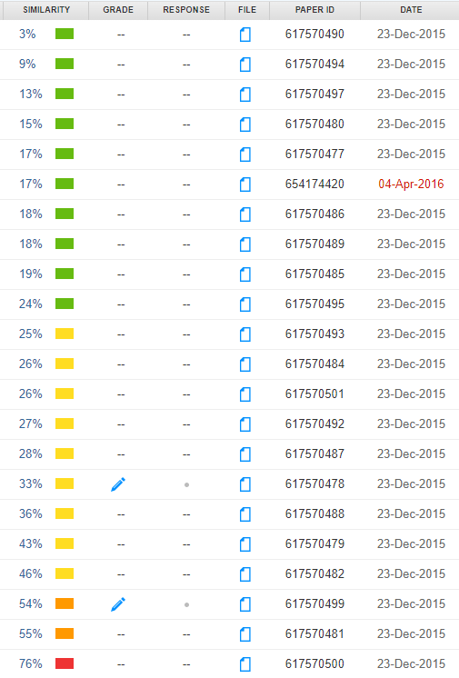
www.turnitin.com demo

Slide 47
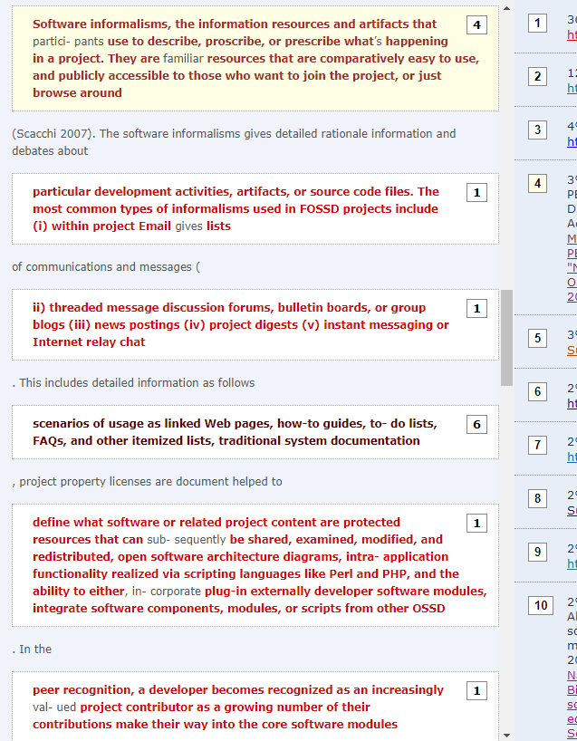
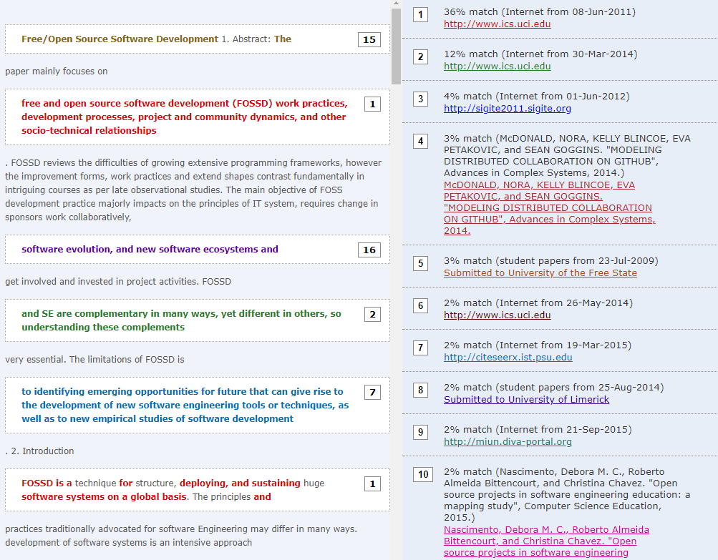
76% report
Notes:
Note the smaller more integrated takes – but still a very big problem
Note the larger takes on the RHS, and how the author has managed to add words – but still a real problem also.
ChatGPT: Generative models – also claiming someone/something else’s work as your own. Very difficult to detect but not impossible – rely mu study – 9/10 correct
Interview defense of what you wrote.

Slide 48
And then there is AI
Largely undetectable? (AiET paper)
But public defence of your dissertation:
  (Just like the poster, assessing)
So what’s responsible-usage here then?
Notes:
Ownership of the material
Agreed transparent usage of AI

Slide 49
EndNote
A reference management system
With the web-version available free
User guidance
https://libguides.ul.ie/referencing-endnote/
It tells you how to:
  Create an account and sign in!
  (Make different folders)
  Several ways of inserting a reference: manually and automatically, from databases (Scopus, Web of Science, Academic Search Complete) into EndNote
  Check you can use Harvard style (“UL Harvard 2016” is fine)
  Import several references and use/cite them (easily) in a Word document

Slide 50
Last critical Reading exercise Spreadsheet paper
Summary
Critique

Slide 51
Spreadsheet paper
Summary
  Problems wrt errors in spreadsheets likely
    Human developers (not software engineers)
    False sense of confidence
    The who-is-using and when issues.
  Yet relied on for medical decisions… see the illustrative paediatrics spreadsheet (+2 others) issue.
Critique
  Illustrative rather than representative;
  O.S. spreadsheets only.
  No real error taxonomy to recognize against
  Solutions…
Notes:
Issues:
No product recall if an error is found.
No constraints/error checking on data entry
Lots of spreadsheet is protected but can be cut and paste (and hinders seeing relationships: BSA sq meter (E21) is never used)
Formula L7 – complexity and variable naming and the .02 comes from K7 when it’s referred to three times as a constant in L7 formula. Could change 1 or K7 and errors occur. Also is another cell had a value 0.02: which cell would the constant reflect?
The milligram/microgram issue (K9): under the mg heading
No documented testing.

